Slide 1
Case Study III
PIZZA STORE SALES ANALYTICS

Slide 2
Assumptions
Exploratory Data Analysis on the Restaurant’s Sales data will help us understand the overall performance.
I have taken a similar Restaurant Menu’s dataset and explored the same to show the key findings and conclusions.
Detailed explanation is available here.

Slide 3
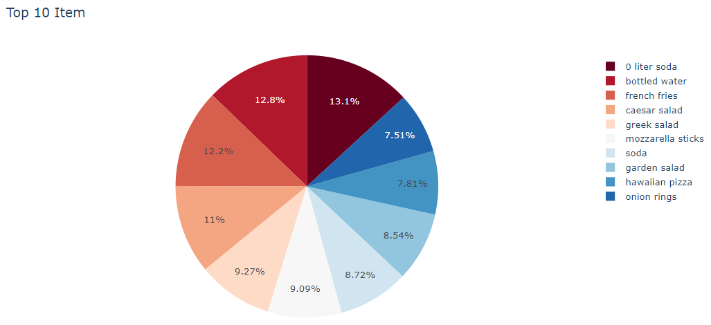
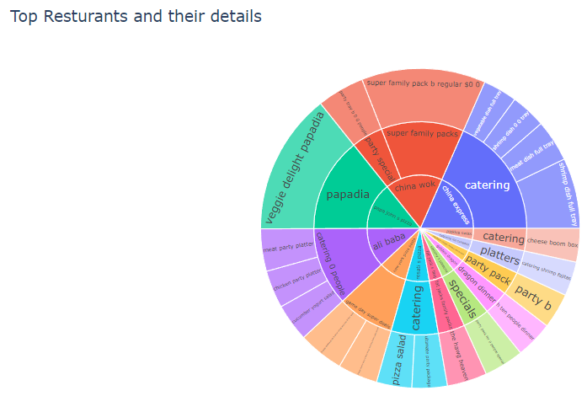
Business Insights
The Pie Chart shows lists the top 10 items which appear the most in the dataset. Perhaps, these are the most popular items.
The interactive sunburst gives a clear picture of the price distribution of each section and item in the top restaurants menu.

Slide 4
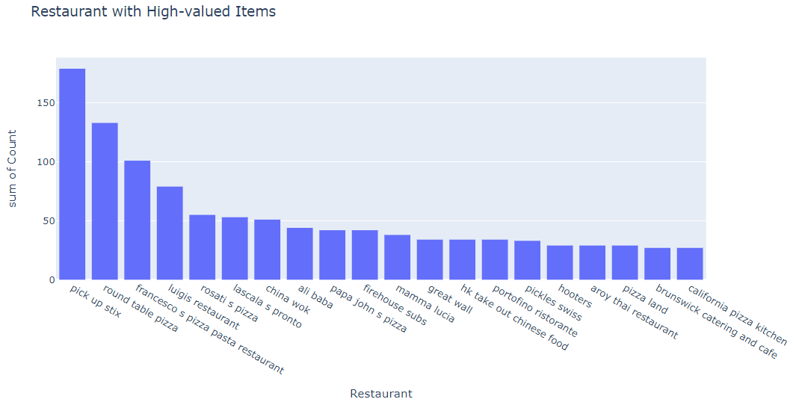
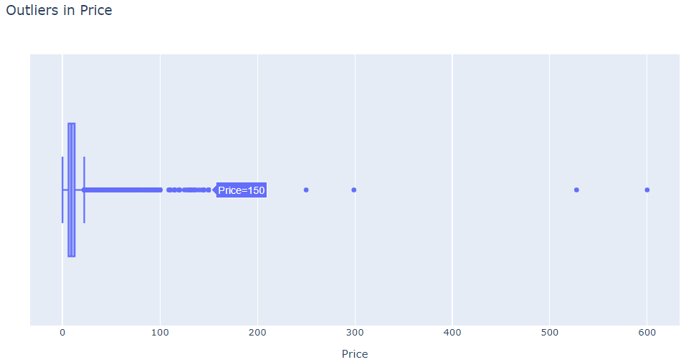
Abnormalities
We have identified the items that are abnormally high
priced. And also the restaurants which have these high
priced items.
The boxplot shows that most of the items are priced in
the range of $2-$25 are a few which are quite expensive.
From the bar chart it is clear that pick up stix restaurant
Has the most number of expensive items.

Slide 5
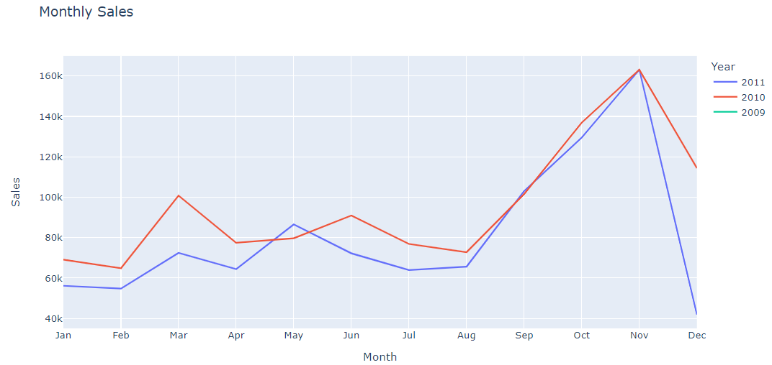
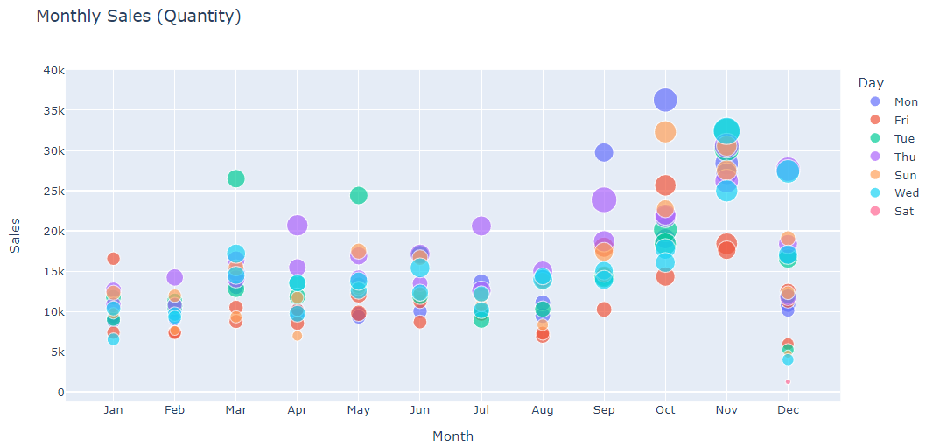
Answers
How’s your store performing?
To answer this we need to consider the periodic sales.
Line charts are a great way to understand the sales trend
over the period of time. Here, December has the least sales.
How your products are performing via online, tele sales, and direct sales channel?
Use Pie Chart to see the distribution of sales for different channels.
What are the KPIs you will consider and How the outcome (through a cool visual dashboard) would look like?
1. Sales Revenue (Line Chart)
2. ROI
3. Customer Retention and Churn Rate (Pie Chart)

Slide 6
Thank You!

